Slide 1

The Business of Software

Slide 2
“IT by itself provides no value”.
Notes:
Bio/Intro:
“IT by itself provides no value”. That’s a pretty bold statement and yet that’s where the winds of business are blowing. As a developer or IT professional you spend time understanding new languages and frameworks, but to deepen and broaden your impact, I recommend taking strides in understanding the business.
In this session we’ll focus on the business of software, from financial concepts, metrics, and the future of IT and enterprise architecture in the corporation. We’ll touch on why your CEO and VP may understand the role of technology more comprehensively than they’re given credit for.
As IT likely touches nearly all aspects of your company, going forward IT professionals will need to know more about business and the role IT plays in the broader organization. This session aims to better equip you to talk business with your company leaders or boss and to make yourself or your team more effective.

Slide 3

About Me
Current:
Vice President of eCommerce MAG Retail Group
Past:
Vice President of Application Development - MAG
Director of Digial Marketplaces - Fusionfarm/The Gazette Company
Director of Marketing and Internet Business – J&P Cycles
Notes:
I have a family of five – 3 kids and a wonderful wife
I’m fascinated by all the opportunities that are around us

Slide 4







My Software History
Passionate software developer for over 13 years
Developing on the .NET platform since the early 2003
Iowa Code Camp Leadership
Leadership of CRIneta (Cedar Rapids, Iowa)
Twitter: @timbarcz
Committer on RhinoMocks OSS project

Slide 5
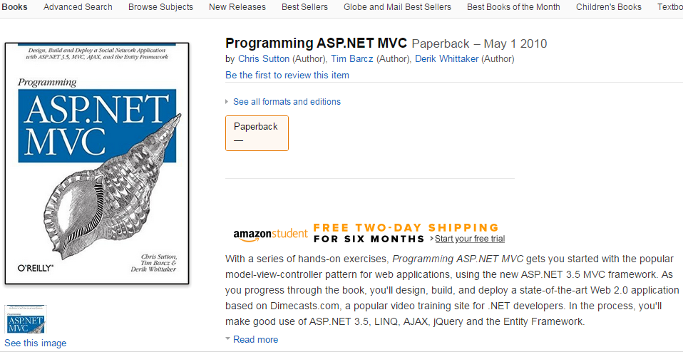


Slide 6




























Retail & Media
Brands
Distribution
Notes:
Over 2,200 employees
About 45 developers across all three divisions

Slide 7





Slide 8
Goals for Our Time Together
Understand financial basics
Understand (at a high level) how decisions are made
Understand the impact we have on the financial metrics
Understand business operating models and apply to your situation
KEY GOAL:
Make better recommendations and be more effective

Slide 9
Finance 101
“There is rarely any real measurement or analysis of how software engineering investments contribute to value creation.”
Barry Boehm, Ph. D.
Software Economics: A Roadmap
Notes:
“Software engineers are usually not involved in or often do not understand enterprise-level value creation objectives. The connections between technical parameters and value creation are understood vaguely, if at all. There is rarely any real measurement or analysis of how software engineering investments contribute to value creation.”
- Barry Boehm, Ph. D. Software Economics: A Roadmap

Slide 10
The Scoring Engine
Return on Investment (ROI)
Cash flow
Net Income
Payback time
Breakeven time (BE)
Present Value (PV) and Net Present Value (NPV)
Cost of Capital / Discount Rate
Internal Rate of Return (IRR)

Slide 11
Key Financial Terms
Return on Investment (ROI):
ROI = (Gains – Cost)/Cost
Example:
If you buy 20 shares of Joe's Pizza for $10 a share, your investment cost is $200. If you sell those shares for $250, then your ROI is 25% ($250-200)/$200. This can be confirmed by taking the cost of $200 and multiplying by 1.25, yielding $250.
Notes:
Example:
ROI can sometimes be tricky because it’s so loosely defined people use it in various contexts. Therefore, know the context but this is the *gist* of ROI (the trick is what is included in cost and gains).

Slide 12
Key Financial Terms
Cash Flow:
The amount of money flowing into or out of the company/project
Cash Flow = Revenues - Cost
“Cash Flow helps you control your destiny” – Jack Welch
Notes:
A revenue or expense stream that changes a cash account over a given period. Cash inflows usually arise from one of three activities - financing, operations or investing. Cash outflows result from expenses or investments. This holds true for both business and personal finance.
Cash flow can be positive or negative. Positive cash flow means more is coming in that going out. Often “cash flow positive” is a milestone in a young companies life.

Slide 13

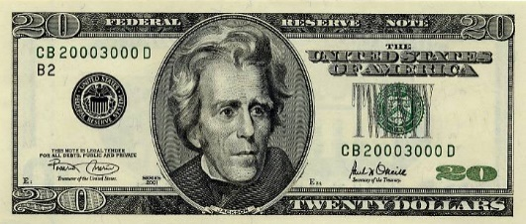
Currency
??
Notes:
Can’t add unlike currencies, you must convert to a common currency before adding

Slide 14
Currency
??
Notes:
Can’t add unlike currencies, you must convert to a common currency before adding

Slide 15
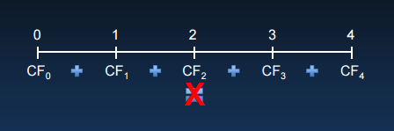
Time Value of Money
Notes:
Similarly money at different points in time is like different currencies, you have to normalize

Slide 16
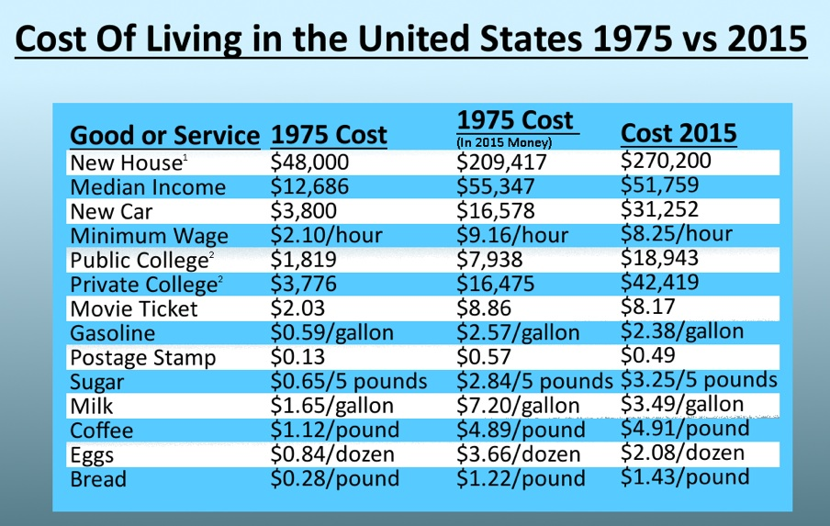

Slide 17
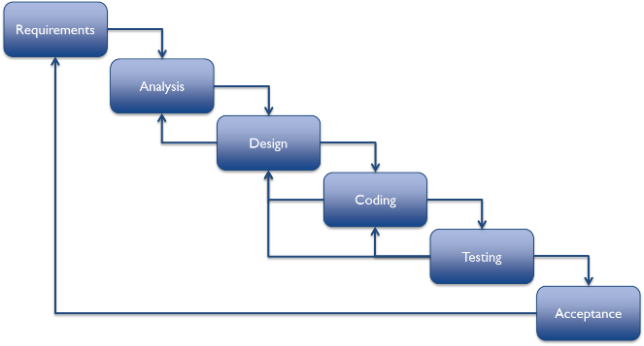
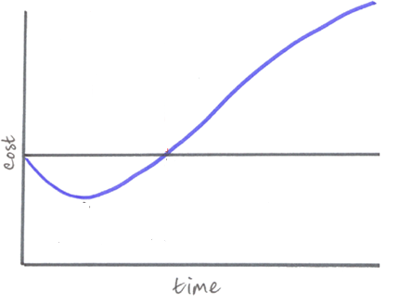
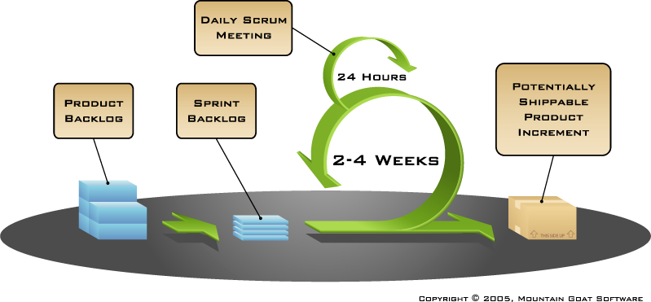
Project Methodology Truths
OR

Slide 18
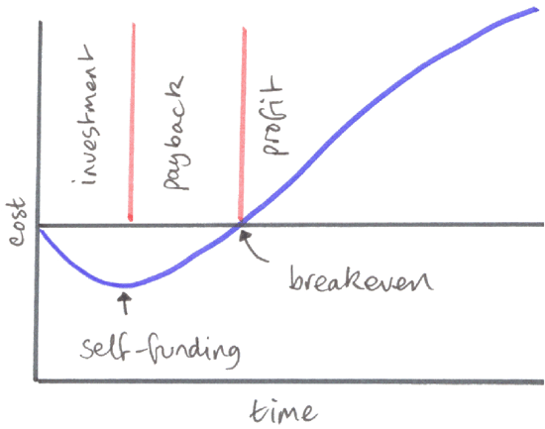
Key Financial Terms
Investment period
Self-funding point
Payback period/time
Breakeven time/point
Profit Period
Notes:
Blue line represents the financial life of a project

Slide 19
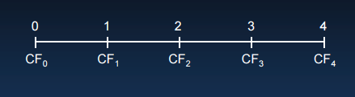
Key Financial Terms
Present Value (PV) the value of a cost or benefit in terms of today’s dollars
Net Present Value (NPV): present value of its benefits – present value of it’s costs
NPV = PV(Benefits) – PV(Costs)
NPV = PV (All project cash flows)

Slide 20
Present Value Example
Example:
Assuming a 10% annual interest rate, $100,000 in 10 years is equal to $38,554 today.
PV = $100,000 / (1 + .10)¹⁰
PV = $100,000 / 2.5937
PV = 38,554
Formula: PV = FV / (1 + i/100)^{n}
i = % interest rate, n = years, FV = future value
Notes:
$1 today is not the same $1 tomorrow. $1 today is not the same as $1 from 1950. Present value allows you to know what some future amount of money is worth in today’s dollars.
Net Present Value is the sum of the present values over the period being reviewed
You can solve this the other direction – solve for the future value of some money you have today.
PV = FV / (1 + i/100)n
FV = PV * (1 + i/100)n
Most commonly how we use future value is the term “inflation”. We intuitively know that a dollar today is worth more than in the future because of

Slide 21
Key Financial Terms
Cost of Capital / Discount Rate:
Cost of Capital = The cost of funds for financing a business
Discount Rate = Used in discounted cash flow analysis to determine present value of future cash flows
Notes:
Cost of Capital and Discount Rate is something that is usually set by your finance department and is not something a developer is responsible for.
Cost of Capital is not just the hard cost of borrowing money, but generally represents the opportunity cost. Thus if I can invest in something and get 10% for my money, the cost of capital is 10% therefore your project has to do better than that return to make it worthwhile to do.

Slide 22
NPV Decision Rule
“When making an investment decision, take the alternative with the highest NPV. Choosing this alternative is equivalent to receiving its NPV in cash today”
Accept projects with a positive NPV
Reject projects with a negative NPV. Accepting them adds no value whereas not doing them has no cost

Slide 23
Key Financial Terms
Internal Rate of Return (IRR):
IRR = The rate of growth a project is expected to generate
Explanation:
The IRR represents the cost of capital when the NPV of the project is equal to zero. Useful for comparing projects with positive NPV.

Slide 24
IRR Decision Rule
“When making an investment decision, if the internal rate of return (IRR) is greater than the hurdle rate the project should chosen.”
Accept projects with a IRR > Hurdle Rate
Reject projects with a IRR < Hurdle Rate

Slide 25
Income Statement Example
Revenue
Product Sales | 300
Less: Discounts | -10
Less: Markdowns | -5
Net Product Sales | 285
Freight Income | 70
Less: Returns | -20
Net Sales | 355
Cost of Goods Sold
Products COGS | 150
Freight In | 5
Freight Out | 60
Net COGS | 215
Gross Profit | 140 | 39%
Expenses
Operating Expenses
Personnel | 25
Facilities | 10
Marketing | 20
G&A | 17
 | 72
EBITDA | 68 | 19%
Notes:
Retail example of J&P Cycles (note, all the numbers here are made up)
EBITA – Earning Before Interest Taxes and Amortization -> proxy for profit

Slide 26
Why should we care?
Notes:
Everything the business does hinges around these concepts to some degree. The software we write adds some value somewhere, cuts some costs via automation or unlocks new sales. This is how the business speaks.

Slide 27
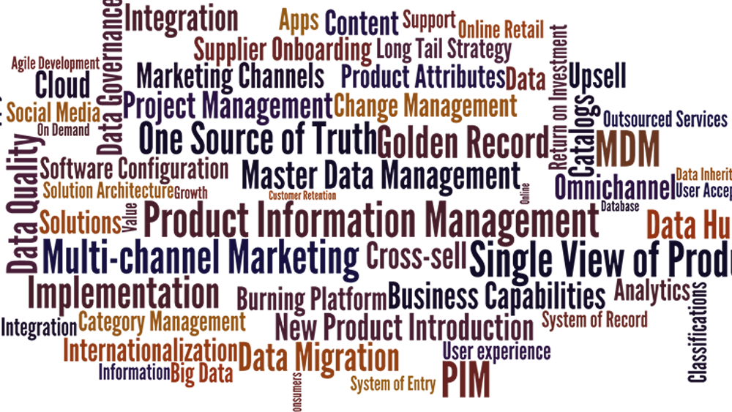

Slide 28
How do I help?
Notes:
Sometimes we should do a project with a lower NPV because of the impact on cash flows
Cash flow vs. NPV – imagine a project that will cost you $1 MM and returns you $5 MM in five years. Another project costs $1 MM and returns you $2 MM in 1 year.
In the first project the revenue doesn’t start coming for 3 years. In other words you have to spend the full $1 MM and pay interest (or opportunity cost) on the money for 3 years before you start to see a return. You don’t hit breakeven until year four ($1 MM returned back in revenue until year 4 (note that the payback time)).
In the second project we spend $1 MM but starts returns the $1 MM investment in 6 months and the other 1 MM in the next six months.
The first project has a much bigger ROI but the demands on cash are much steeper than the second project.
Breaking features up into smaller components (often called minimal marketable features, or MMFs) allow you to break large projects into smaller components which can have their NPVs or IRRs compared
Understand what impacts Agile methodologies and shipping early have on the income statement.

Slide 29
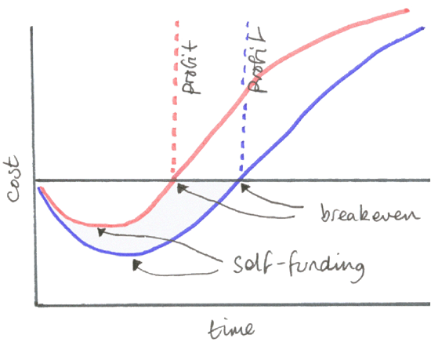
Your Goal As a Software Professional

Slide 30
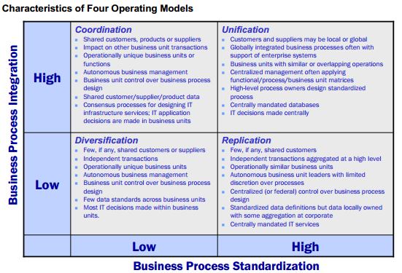
Four Operating Models
Notes:
Coordination – unique business units with a need to know each other’s transactions
Key IT – access to shared data, through standard technology interfaces
Diversification – independent business units with different customers and expertise
Key IT – provide economies of scale without limiting independence
Unification – single business with global process standards and global data access
Key IT – enterprise systems reinforcing standard processes and providing global data access
Replication – independent but similar business units sharing best practices
Key IT – provide standard infrastructure and application components for global efficiencies

Slide 31
Two Axes
Standardization – defining exactly how a process will be executed regardless of who is performing the process or where it is completed.
Integration – links the efforts of organizational units through shared data. Sharing can be between processes to enable end-to-end transaction processing, or across processes to allow the company to present a single faced to customers.

Slide 32
Four Operating Models

Slide 33
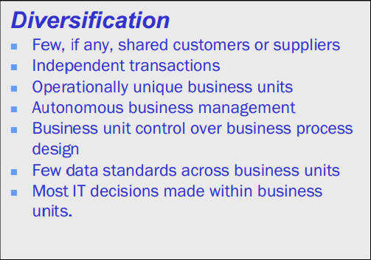

Operating Models: Diversification
Example:

Slide 34
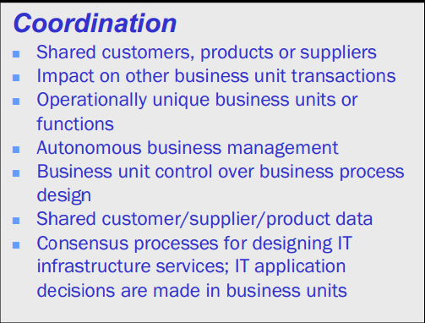

Operating Models: Coordination
Example:

Slide 35
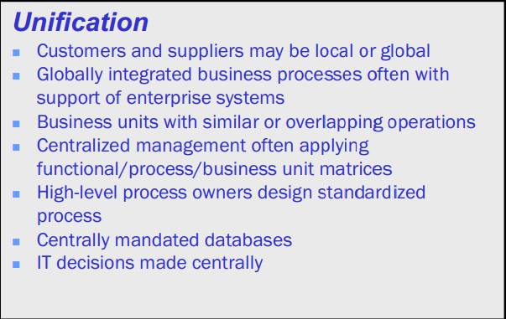

Operating Models: Unification
Example:

Slide 36
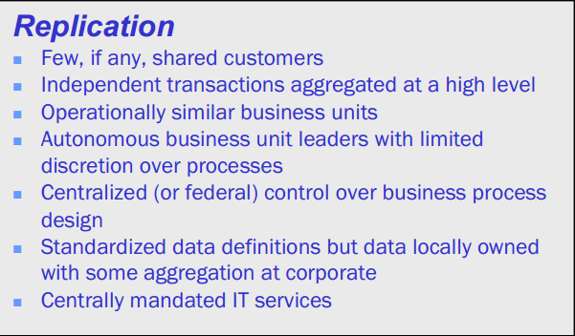


Operating Models: Replication
Example:

Slide 37
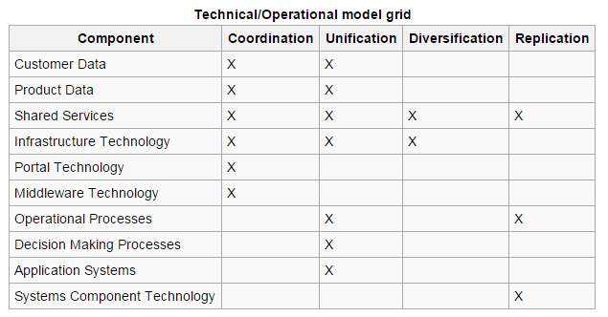

Slide 38


Diversification
Retail & Media
Brands
Distribution
Coordination
Unification
Notes:
LDI – Ultimed, MAG, OIA Global (Diversification)
MAG – Retail/Media, Brands, Distribution (Coordination)
MAG Retail – J&P Cycles, Motorcycle Superstore (Unification)

Slide 39
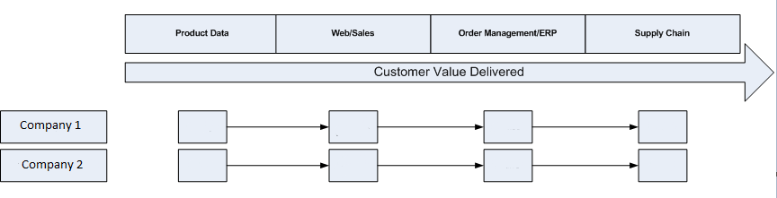
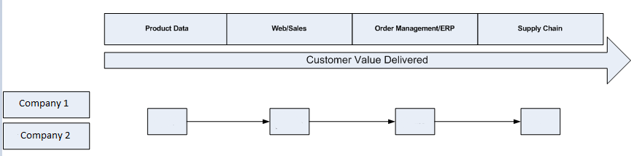
Diversification to Unification

Slide 40
Enterprise Architecture
Notes:
“Most of the effort to define enterprise architecture has been located in companies’ IT units. But the historic ineffectiveness of IT architecture efforts in large organizations has troubled us for years. In presentations we have railed against traditional IT architecture efforts for their remoteness from reality of the business and their heavy reliance on mind-numbing detail represented in charts that look more like circuit diagrams than business descriptions and that are useful as little more than doorstops”
- Enterprise Arch as Strategy

Slide 41
Enterprise Architecture
Is the organizing logic for business processes and IT infrastructure reflecting the integration and standardization requirement of the company’s operating model. The enterprise architecture provides a long-term view of a company’s processes, systems, and technologies so that individual projects can build capabilities – not just fulfill immediate needs.

Slide 42
Enterprise Architecture vs. IT Architecture
Enterprise Architecture
Focused on communicating high-level business process and IT requirements of a company’s operating model.
IT Architecture
Typically four levels of architecture
Business process architecture
Data architecture
Application architecture
Technology architecture
“When IT units attempt to develop detailed architectures without a clear understanding of the company’s enterprise architecture, they may have developed the equivalent of a fondue pot – an ornament rather than a tool”

Slide 43
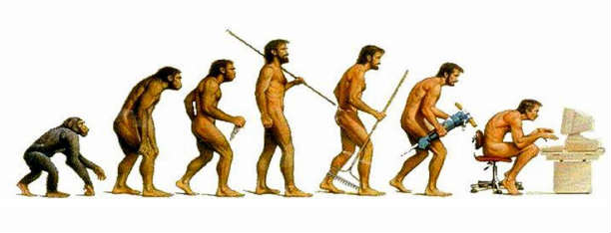
Maturity Models
Four stages of maturity:
Business Silos
Technology Standardization
Optimized Core
Business Modularity
Notes:
Cannot skip stages
Each layer require the learning of new behaviors

Slide 44
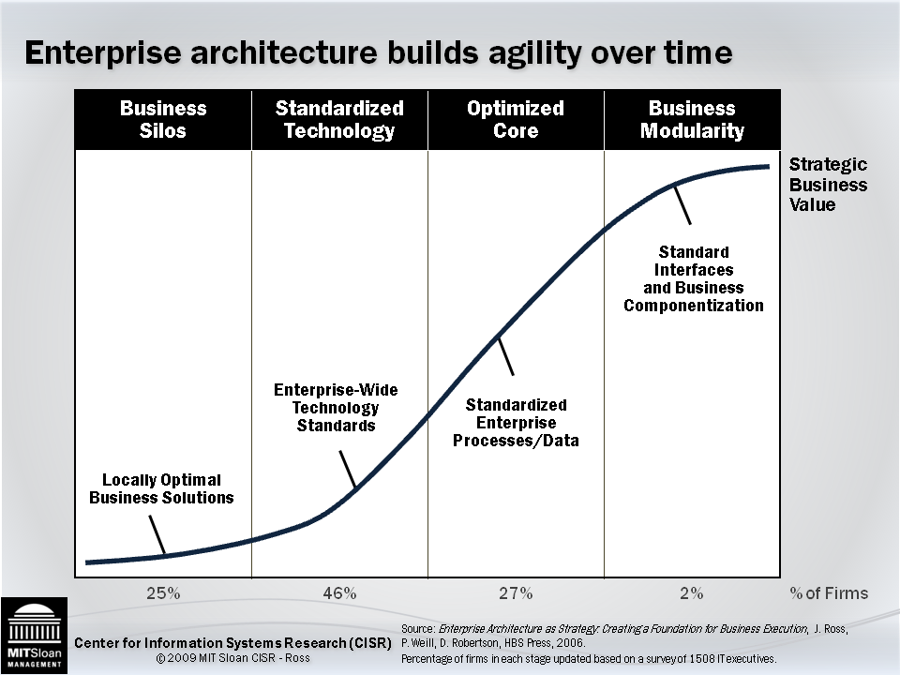
Architectural Maturity Stages
Notes:
Business Silos
companies focus their IT investment on delivering solutions for local business problems and opportunities.
IT investments are usually justified on basis of cost reductions
Lots of one-off solutions that solve local problems.
Obstructs integration and standardization of business processes
Frustration doesn’t drive movement from this stage, it’s the cost
Standardized Technology
Companies establish standards intended to decrease the number of platforms they manage
Fewer platforms means lower cost
Technology standards key at this stage
Reduces risk
Reliability, security, and development time improves
Optimized Core
Move from local view to enterprise view
IT teams facilitate achievement of objectives by building reusable data and business process platforms
Involves taking control over business process design from local business unit leaders. Much harder sell to business managers than earlier stages.
Business Modularity
- Enables strategic agility through customized and reusable modules.

Slide 45
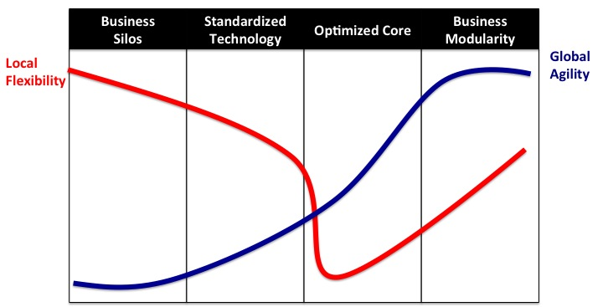
Architectural Maturity Stages
Notes:
“An individual can view any standard as an unnecessary constraint or as a simplifying mechanism”

Slide 46
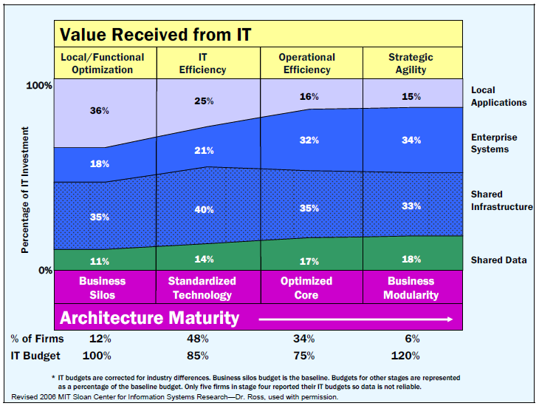
Architectural Maturity Stages
Notes:
Walk through maturity
Note reduction in local applications as more maturity comes
IT savings of 15% and 25% respectively to move to Standardized Tech and Optimized Core
“In contrast, 12 percent of the companies we studied are frittering away management attention and technology investments on a myriad of (perhaps) locally sensible projects that don’t support enterprisewide objectives”
- Enterprise Architecture as Strategy

Slide 47
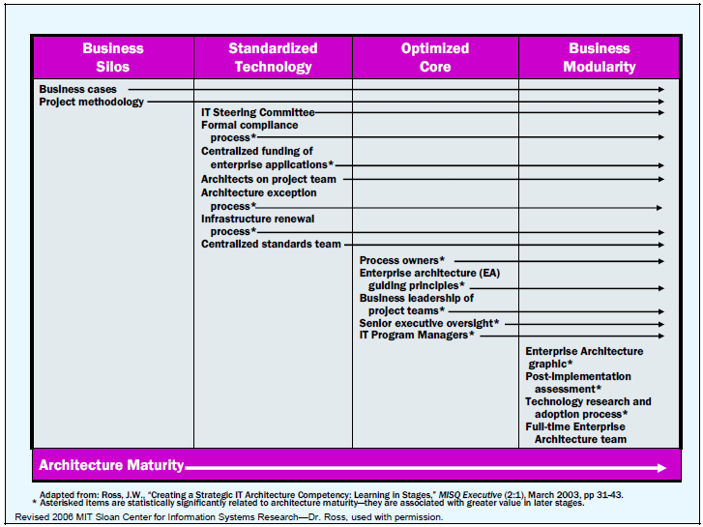
Management Practices
Notes:
New behaviors and management practices needed at each stage to bring success

Slide 48
Resources
Software By The Numbers – Deane, Cleland-Huang
Enterprise Architecture as Strategy – Ross, Weill, Robertson
Lean Software Development –Poppendieck
An Introduction To Enterprise Architecture - Bernard
FruITion, RecrEAtion, DefrICtion – Potts
MIT Center for Information Systems Research (CISR) http://cisr.mit.edu/

Slide 49
Stay in Touch
Twitter: @timbarcz
Email: tim.barcz@magretailgroup.com

